Slide 1
ANALYSIS ON MOVIE DATASET
Group 7

Slide 2
Agenda
Hollywood Management Consulting- What we do and who are we?
Oliver Stone as a major account of HPG
Movie Database- Data understanding
Data exploration using descriptive analytics
Data preparation
Modeling (e.g. regression, classification, cluster, etc.)
Insights and Recommendation

Slide 3
HPG- what we do?
20 year old super successful PR consulting firm focused on Hollywood and based in LA
New foray into Data Science to step change our consulting to our clients

Slide 4
HPG- Who we Are?
ROLES | WHO
HMG Team Director | Anirudh
Major Account Manager | Shruti
Business Analyst | Radhika
Data Scientists | Apurva, Devvrit

Slide 5



Oliver Stone as a major account
?
“Show me what Data Science can do?”

Slide 6
1a.UNDERSTANDING THE BUSINESS CASE
PROVIDE RECOMMENDATION FOR SCORE RATING, GROSS REVENUE FOR THE NEXT MOVIE
RECOMMENDATIONS TO DIRECTOR FOR THE ABOVE BASED ON THE FOLLOWING INPUTS:
BUDGET
GENRE OF MOVIE
MONTH OF RELEASE
RUNTIME MINUTES
ALSO PROVIDE GUIDANCE ON:
PREFERABLE MONTH TO RELEASE MOVIE IN
RANGE FOR RUNTIME MINUTES

Slide 7
1b. MOVIE DATABASE- DATA UNDERSTANDING
Col name | What it is? | Data type
budget | Budget of the movie | Numeric
company | Studio that made the movie | String
country | Country where it was made | String
director | Director of the movie | String
genre | Genre of movie | String
gross | Gross earnings of the movie | Numeric
Name | Name of the movie | String
Rating | Rating of the movie | String
Released | Date of release of movie | DateTime
Runtime | Duration of the movie | Numeric
Score | Audience rating of the movie | Numeric
Star | Lead star of the movie | String
Votes | No. of votes who voted | Numeric
Writer | Story/ script writer | String
Year | Year of release | Numeric
Downloaded from Kaggle: Three decades of movie data (1986-2016)
Cols marked in red have been analysed further

Slide 8
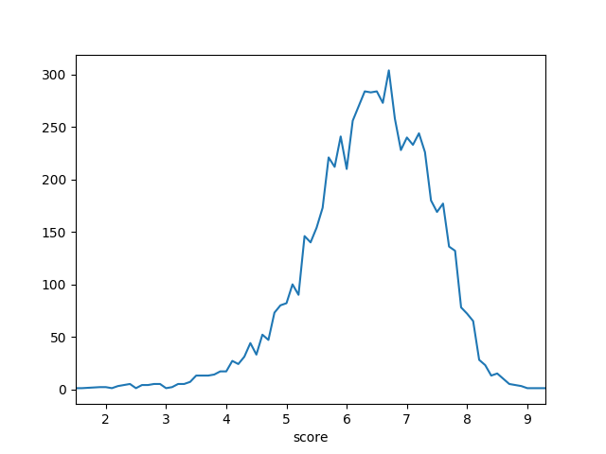
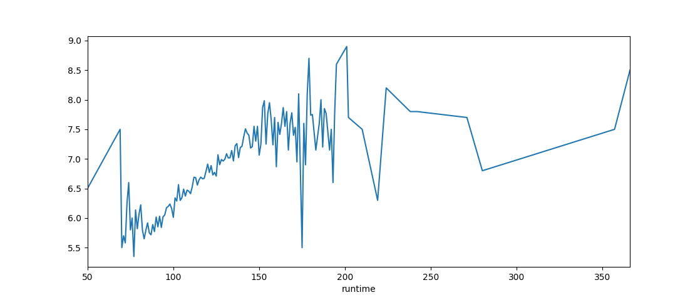
2.DATA EXPLORATION
SCORE VS NO. OF MOVIES
RUNTIME OF MOVIE VS SCORE
NO. OF MOVIES→
AVG RATING →
SCORE →
RUNTIME →

Slide 9
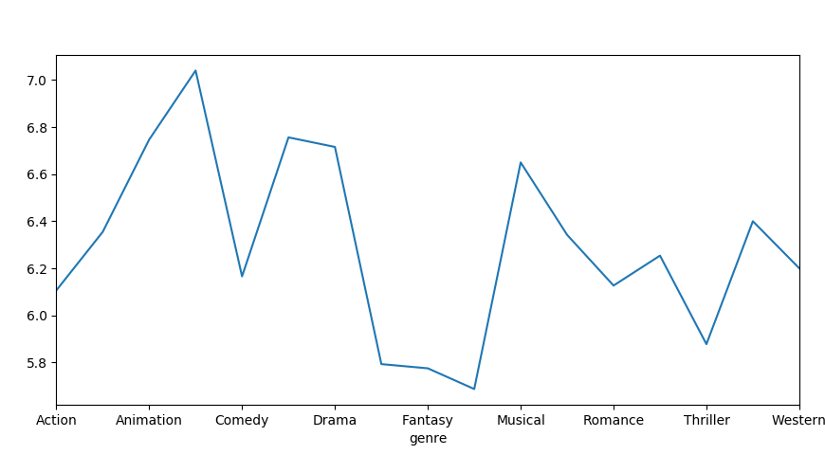
2.DATA EXPLORATION
GENRE VS AVERAGE SCORE
COMPOSITION OF MOVIE GENRES IN DATASET
AVERAGE SCORE →
GENRE→

Slide 10
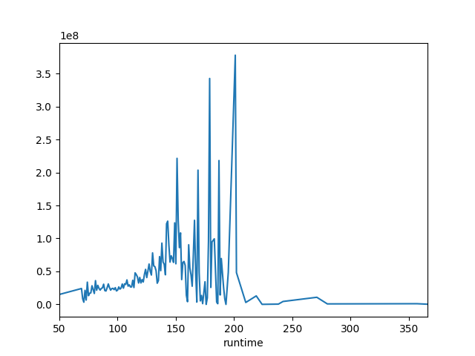
2.DATA EXPLORATION
RUNTIME OF MOVIE VS AVERAGE REVENUE GROSSED
AVG REVENUE GROSSED (USD)
RUNTIME →

Slide 11
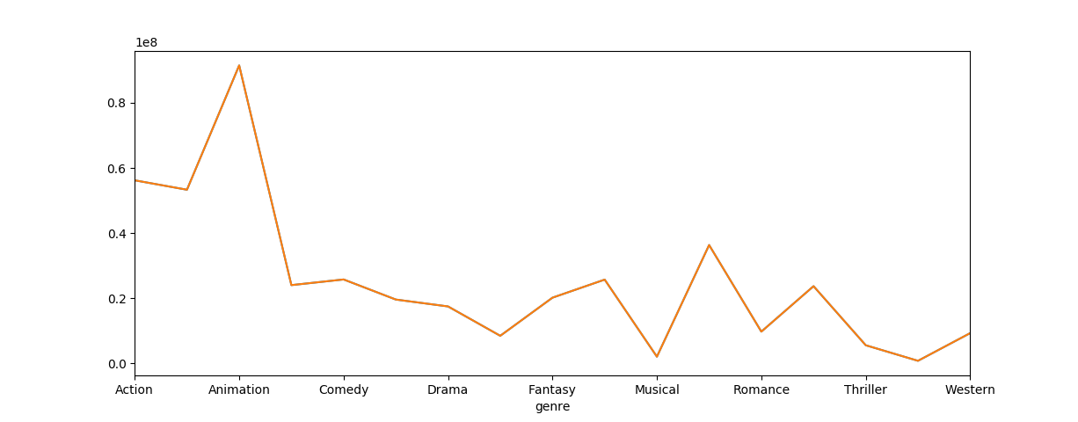
2.DATA EXPLORATION
GENRE VS AVERAGE GROSS REVENUE
GROSS REVENUE (USD)→
GENRE→

Slide 12
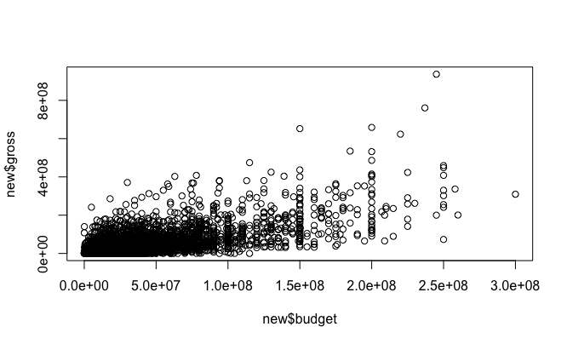
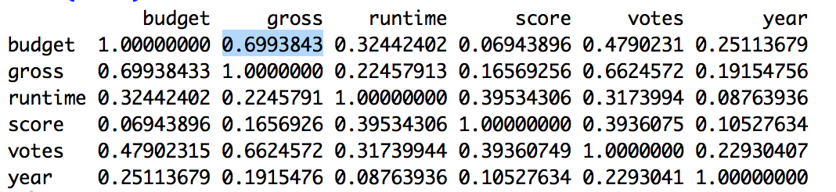
2.DATA EXPLORATION
BUDGET VS GROSS REVENUE
CORRELATION MATRIX
Insight: Linear relation between Budget and Gross Revenue with some outliers

Slide 13
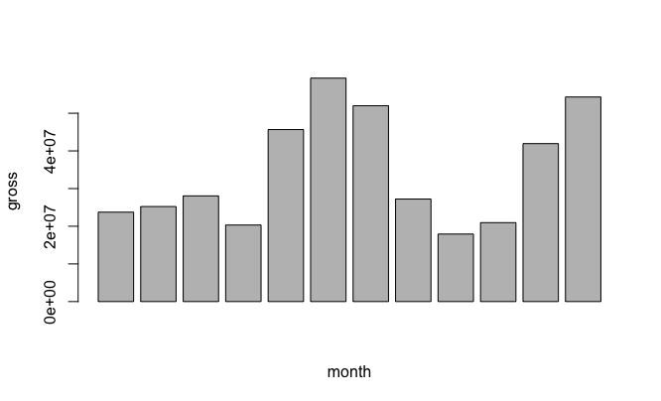
2.DATA EXPLORATION
MONTH OF RELEASE VS GROSS REVENUE
Insight: Higher revenue in Summer and Winter months

Slide 14
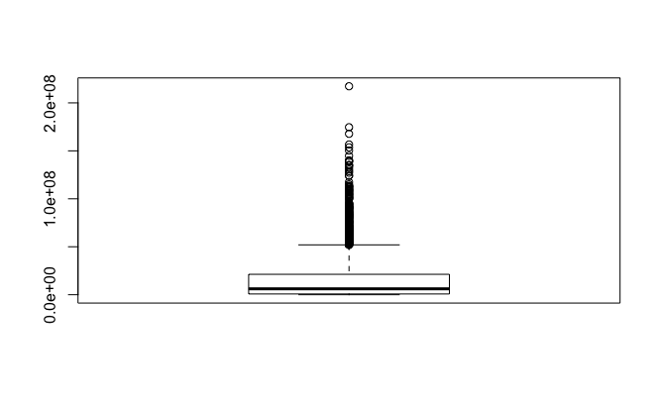
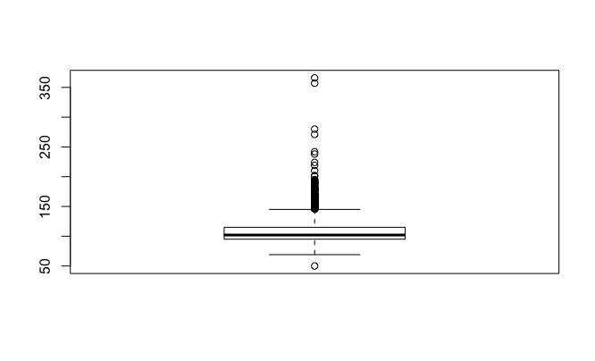
3.DATA PREPARATION
BOXPLOT OF GROSS REVENUE
BOXPLOT OF MOVIE RUNTIME

Slide 15
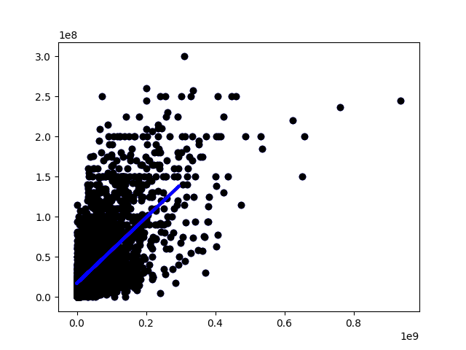
3.DATA PREPARATION
HANDLING MISSING VALUES OF MOVIE BUDGET
GROSS REVENUE (USD) →
A LINEAR PLOT WAS OBTAINED
BUDGET OF MOVIE (USD) →
BLUE LINE INDICATES THE RESULTANT REGRESSION LINE

Slide 16
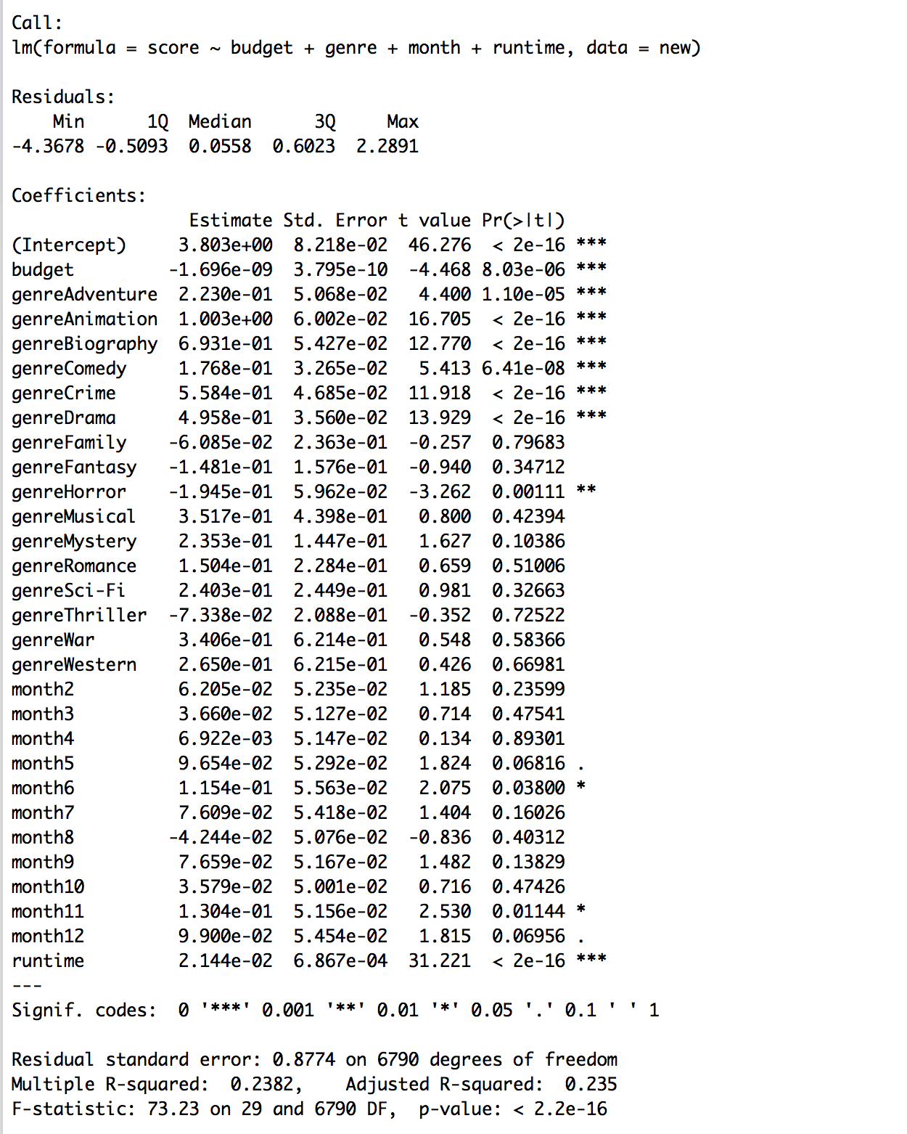
4. DATA MODELLING
MULTI LINEAR REGRESSION OF RATING ON BUDGET,GENRE AND MONTH
SIGNIFICANT GENRES THE DIRECTOR CAN SELECT:
1.ADVENTURE
2.ANIMATION
3.DRAMA
4.BIOGRAPHY
SUGGESTED MONTHS:
1.JUNE
2.NOVEMBER
3.DECEMBER

Slide 17
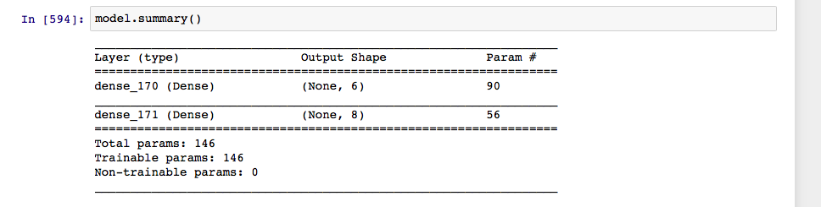
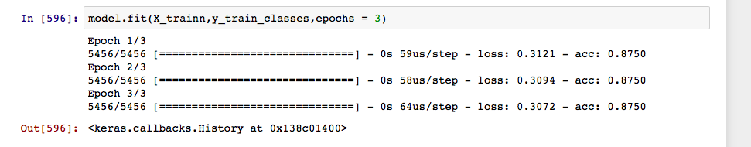
4. DATA MODELLING
NEURAL NETWORKS ON THE SCORE FOR THE MOVIE WITH INPUTS- BUDGET, RUNTIME, MONTH and GENRE

Slide 18
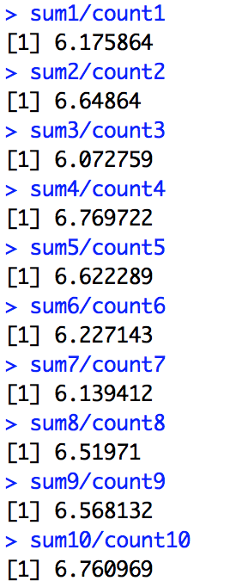
4. DATA MODELLING
K-MEANS ON THE SCORE FOR THE MOVIE
K-MEANS is not suitable for this dataset as most of the movies have their score around 6 and 7. Thus every iteration divides one globular structure instead of classifying the score of the movie into clusters

Slide 19
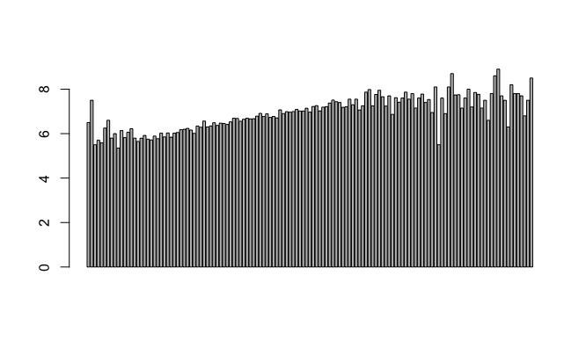
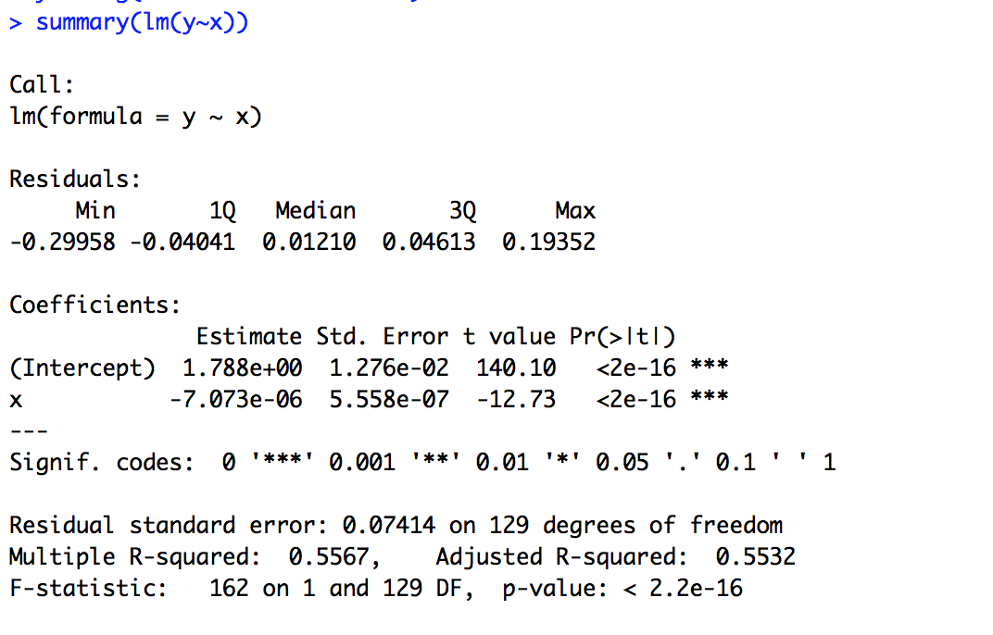
4. DATA MODELLING
PLOTTING RUNTIME VS AVERAGE SCORE
LINEAR REGRESSION OF AVERAGE GROSS REVENUE ON THE SCORE FOR THE MOVIE
AVERAGE SCORE →
RUNTIME →

Slide 20
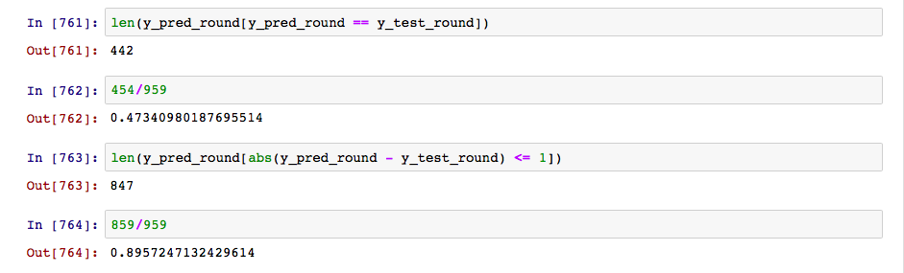
4. DATA MODELLING
ACCURACY OF LINEAR REGRESSION MODEL

Slide 21
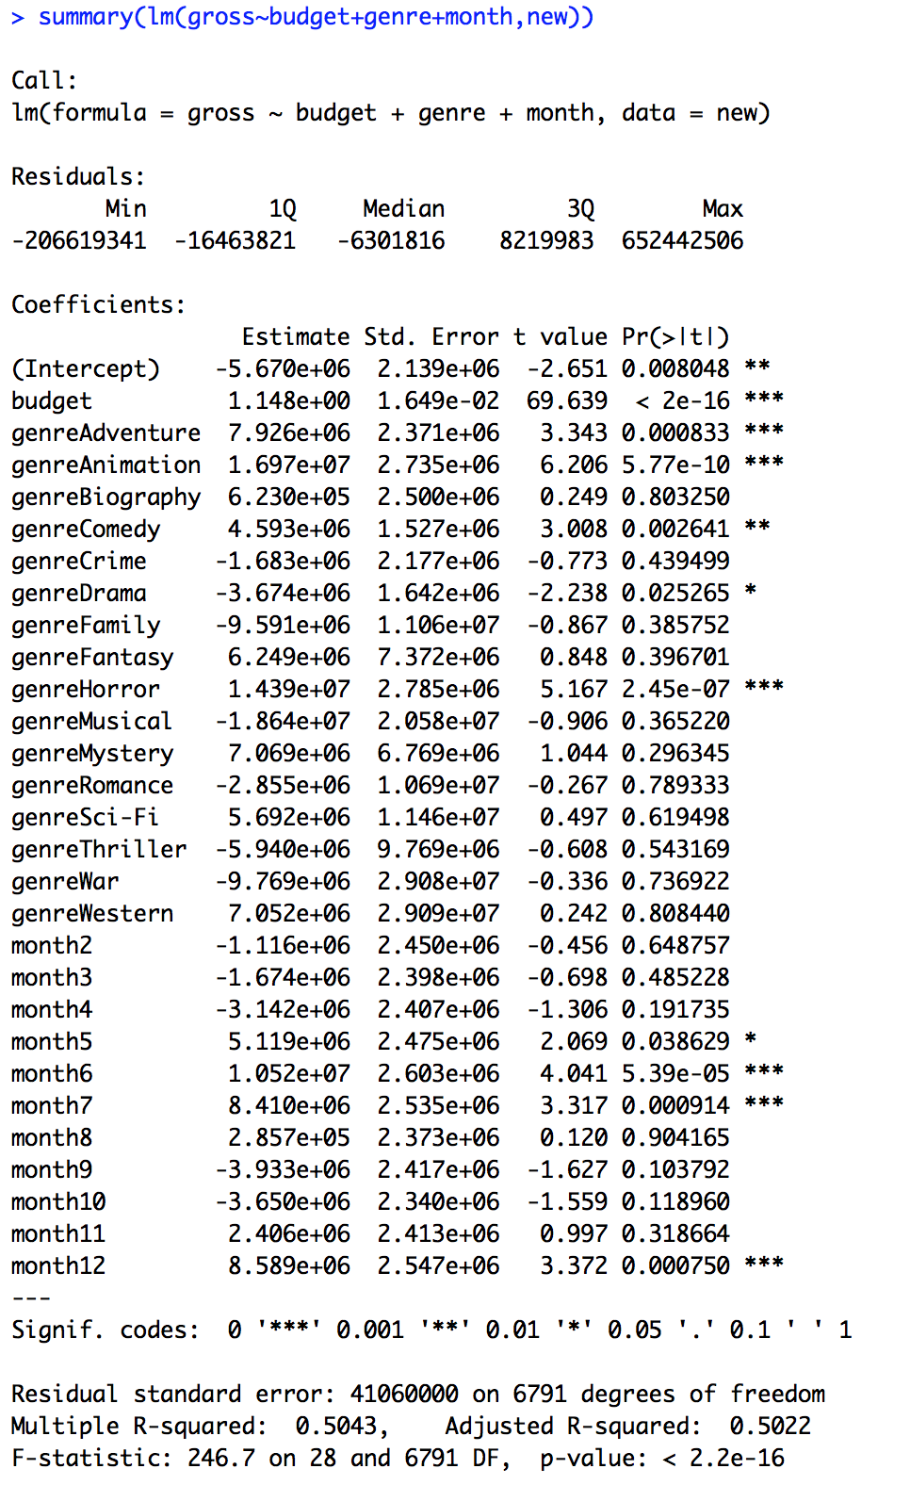
4. DATA MODELLING
MULTI LINEAR REGRESSION OF GROSS REVENUE ON BUDGET,GENRE AND MONTH
SIGNIFICANT GENRES THE DIRECTOR CAN SELECT:
1.ADVENTURE
2.ANIMATION
3.COMEDY
4.MUSICAL
SUGGESTED MONTHS:
1.JUNE
2.JULY
3.DECEMBER

Slide 22
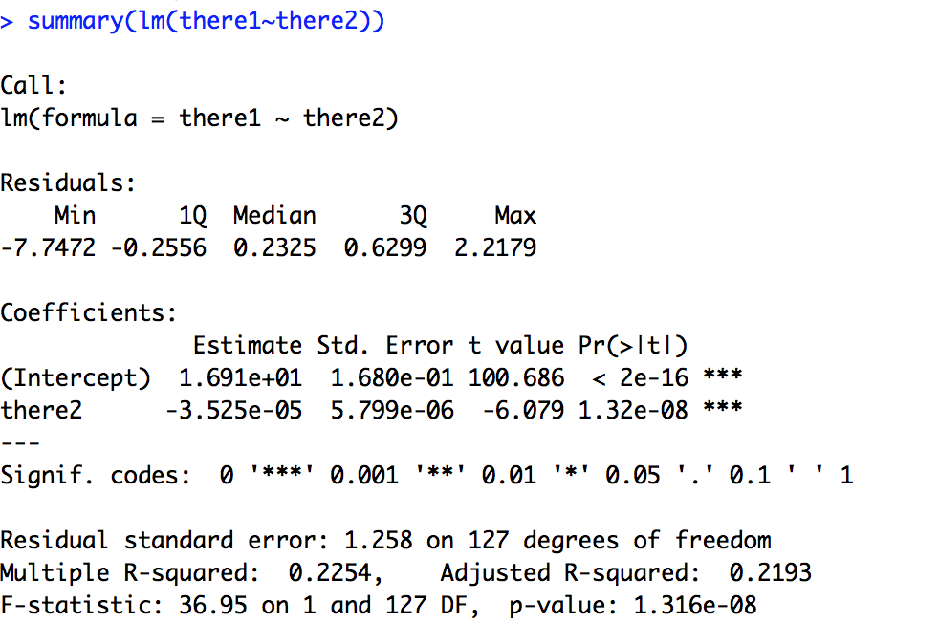
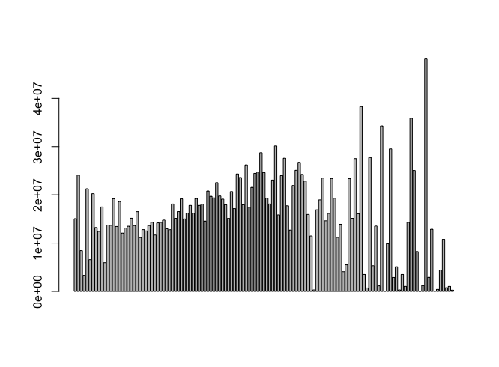
PLOTTING RUNTIME VS AVERAGE GROSS
LINEAR REGRESSION OF AVERAGE GROSS REVENUE ON THE RUNTIME OF THE MOVIE
GROSS REVEVUE→
RUNTIME →

Slide 23
5. INSIGHTS AND RECOMMENDATIOINS
FROM OUR ANALYSIS,WE INFER THAT FOR A MOVIE TO BE A BLOCKBUSTER IN TERMS OF SCORE,
THE RECOMMENDED GENRE: GENRES TO BE AVOIDED:
1.ANIMATION 1.CRIME
2.HORROR 2.DRAMA
3.ADVENTURE
4.COMEDY
THE RECOMMENDED RELEASE MONTH:
1.JUNE
2.NOVEMBER
3.DECEMBER
RECOMMENDED RUNTIME:
175 – 225 mins

Slide 24
5. INSIGHTS AND RECOMMENDATIOINS
FROM OUR ANALYSIS,WE INFER THAT FOR A MOVIE TO BE A BLOCKBUSTER IN TERMS OF REVENUE,
THE RECOMMENDED GENRE: GENRES TO BE AVOIDED:
1.ANIMATION 1.HORROR
2.BIOGRAPHY 2.FANTASY
3.CRIME
4.DRAMA
THE RECOMMENDED RELEASE MONTH:
1.JUNE
2.JULY
3.DECEMBER
RECOMMENDED RUNTIME:
150 – 200 mins

Slide 25
There’s a LOT more that HPG- Data Science can do

